Slide 1
Logistic Regression

Slide 2
Binary Target

Slide 3
Binary Target
Assume a data set has a BINARY Target Variable: 0 or 1
Linear (OLS) Regression cannot be used to predict this target because:
Errors won’t be normally distributed
Probability value from OLS regression can take on values > 100% or < 0%
Even if the Predicted value is truncated, the predictions are usually not good

Slide 4
Binary Target
Logistic Regression
Uses Maximum Likelihood algorithm
Predicts LOG-ODDS (“LOGIT”) of target (value can range from +/- Infinity)
Logit can be converted to a Probability Score ranging from 0% to 100%
Most common method of dealing with Binary Targets
Easy to write scoring code
Easy to interpret coefficients

Slide 5
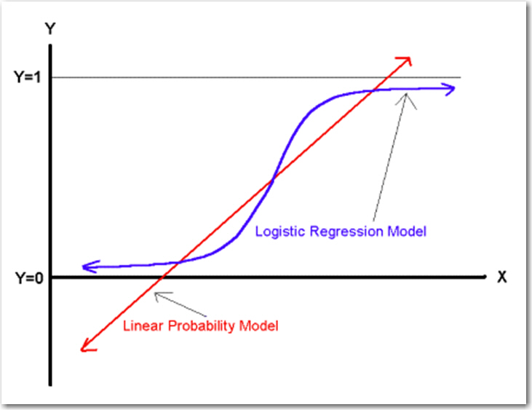
Binary Target

Slide 6
Binary Target
Probit Regression
Uses Maximum Likelihood algorithm
Predicts a “Z-Score” of target (value can range from +/- Infinity)
Z-Score can be converted to a Probability Score ranging from 0% to 100%
Z-Score is transformed into Probability: Cumulative Density Function of Normal Curve
Not as common as Logistic Regression
People are exposed to Logistic more that Probit, so more familiar with Logistic
Probit gives similar accuracy, so no reason to change
More difficult to interpret the coefficients of Probit model
No simple formula to convert Z-Score to Probability … luckily many languages like SAS do have a function to convert Z-Scores to Probability).
For a given PROBABILITY, the LOGIT and Z-SCORE are almost identical:

Slide 7
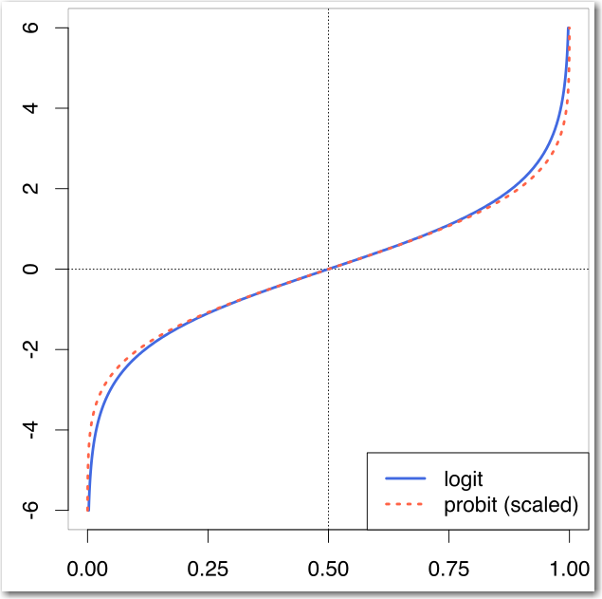
Binary Target

Slide 8
Logistic Regression
Overview

Slide 9
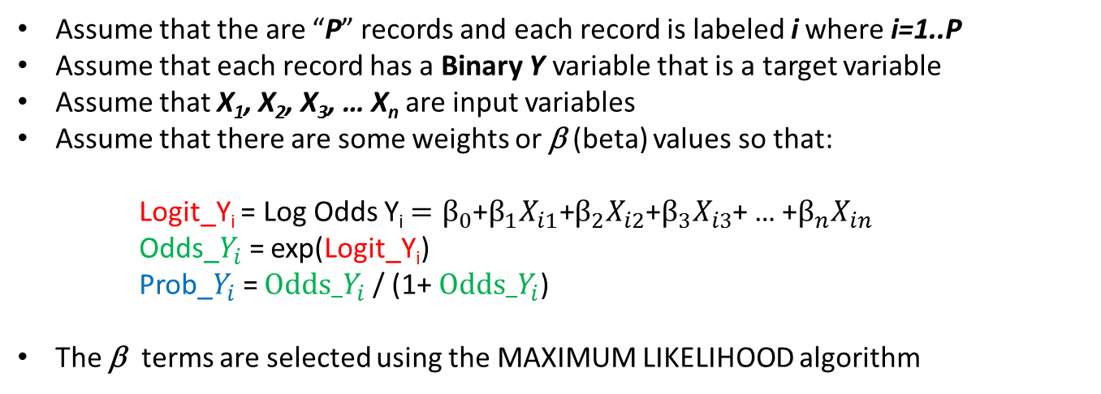
Logistic Regression Review
Assume that the are “P” records and each record is labeled i where i=1..P
Assume that each record has a Binary Y variable that is a target variable
Assume that X₁, X₂, X₃, … X_{n} are input variables
Assume that there are some weights or β (beta) values so that:
Logit_Y_{i} = Log Odds Y_{i} $=β_{0}$+$β_{1}X_{i1}\text{+}β_{2}X_{i2}$+$β_{3}X_{i3}$+ … +$β_{n}X_{in}$
Odds_$Y_{i}$= exp(Logit_Y_{i})
Prob_$Y_{i}$= $Odds_Y_{i}$ / (1+ $Odds_Y_{i}$)
The β terms are selected using the MAXIMUM LIKELIHOOD algorithm

Slide 10

Logistic Regression Review
EXAMPLE:
Assume:
X6 = 20
X8 = 35.3
Logit_Y_{i} = $\text{−327.0 + 20.5993∗}\text{X}\text{6 − 2.0414∗}\text{X}\text{8}$
Odds_$Y_{i}$= exp(Logit_Y_{i})
Prob_$Y_{i}$= $Odds_Y_{i}$ / (1+ $Odds_Y_{i}$)

Slide 11

Logistic Regression Review
EXAMPLE:
Assume:
X6 = 20
X8 = 35.3
Logit_Y_{i} = $\text{−327.0 + 20.5993∗}\text{20}\text{ − 2.0414∗}$35.3
Odds_$Y_{i}$= exp(Logit_Y_{i})
Prob_$Y_{i}$= $Odds_Y_{i}$ / (1+ $Odds_Y_{i}$)

Slide 12

Logistic Regression Review
EXAMPLE:
Assume:
X6 = 20
X8 = 35.3
12.925 = $\text{−327.0 + 20.5993∗}\text{20}\text{ − 2.0414∗}$35.3
Odds_$Y_{i}$= exp(Logit_Y_{i})
Prob_$Y_{i}$= $Odds_Y_{i}$ / (1+ $Odds_Y_{i}$)

Slide 13

Logistic Regression Review
EXAMPLE:
Assume:
X6 = 20
X8 = 35.3
12.925 = $\text{−327.0 + 20.5993∗}\text{20}\text{ − 2.0414∗}$35.3
Odds_$Y_{i}$= exp(12.925)
Prob_$Y_{i}$= $Odds_Y_{i}$ / (1+ $Odds_Y_{i}$)

Slide 14

Logistic Regression Review
EXAMPLE:
Assume:
X6 = 20
X8 = 35.3
12.925 = $\text{−327.0 + 20.5993∗}\text{20}\text{ − 2.0414∗}$35.3
410273.8 = exp(12.925)
Prob_$Y_{i}$= $Odds_Y_{i}$ / (1+ $Odds_Y_{i}$)

Slide 15

Logistic Regression Review
EXAMPLE:
Assume:
X6 = 20
X8 = 35.3
12.925 = $\text{−327.0 + 20.5993∗}\text{20}\text{ − 2.0414∗}$35.3
410273.8 = exp(12.925)
Prob_$Y_{i}$=410273.8/ (1+410273.8)

Slide 16

Logistic Regression Review
EXAMPLE:
Assume:
X6 = 20
X8 = 35.3
12.925 = $\text{−327.0 + 20.5993∗}\text{20}\text{ − 2.0414∗}$35.3
410273.8 = exp(12.925)
0.999998=410273.8/ (1+410273.8)

Slide 17

Logistic Regression Review
EXAMPLE:
Assume:
X6 = 20
X8 = 35.3
12.925 = $\text{−327.0 + 20.5993∗}\text{20}\text{ − 2.0414∗}$35.3
410273.8 = exp(12.925)
0.999998=410273.8/ (1+410273.8)
PROB that Y=1 is 99.9998%

Slide 18
Logistic Regression
Example

Slide 19
Logistic Regression: Example
This example is taken from the previously mentioned Draper and Smith reference.
The data describes monthly steam usage in a manufacturing plant
Y_Temp Monthly use of steam
Y 1: Y_Temp > 10
0: Y_Temp <= 10
X6 Operating days per month
X8 Average temperature in degrees Fahrenheit
NOTE: Draper and Smith named their variables X6 and X8, don’t worry about that. The names of the variables are not important and don’t affect the formula.
Raw Data is given on the following slide.
R Code is provided as a separate file.

Slide 20
Logistic Regression: Example
Raw Steam Usage Data
 | X6 | X8 | Y
1 | 20 | 35.3 | 10.98
2 | 20 | 29.7 | 11.13
3 | 23 | 30.8 | 12.51
4 | 20 | 58.8 | 8.4
5 | 21 | 61.4 | 9.27
6 | 22 | 71.3 | 8.73
7 | 11 | 74.4 | 6.36
8 | 23 | 76.7 | 8.5
9 | 21 | 70.7 | 7.82
10 | 20 | 57.5 | 9.14
11 | 20 | 46.4 | 8.24
12 | 21 | 28.9 | 12.19
13 | 21 | 28.1 | 11.88
14 | 19 | 39.1 | 9.57
15 | 23 | 46.8 | 10.94
16 | 20 | 48.5 | 9.58
17 | 22 | 59.3 | 10.09
18 | 22 | 70 | 8.11
19 | 11 | 70 | 6.83
20 | 23 | 74.5 | 8.88
21 | 20 | 72.1 | 7.68
22 | 21 | 58.1 | 8.47
23 | 20 | 44.6 | 8.86
24 | 20 | 33.4 | 10.36
25 | 22 | 28.6 | 11.08

Slide 21
Logistic Regression: Example
R code to read in raw data
############ Setting up individual variables
x6<-c(20,20,23,20,21,22,11,23,21,20,20,21,21,19,23,20,22,22,11,23,20,21,20,20,22)
x8<-c(35.3,29.7,30.8,58.8,61.4,71.3,74.4,76.7,70.7,57.5,46.4,28.9,28.1,39.1,46.8,48.5,59.3,70,70,74.5,72.1,58.1,44.6,33.4,28.6)
ytemp<-c(10.98,11.13,12.51,8.4,9.27,8.73,6.36,8.5,7.82,9.14,8.24,12.19,11.88,9.57,10.94,9.58,10.09,8.11,6.83,8.88,7.68,8.47,8.86,10.36,11.08)
y<-ifelse(ytemp>10,1,0)
mydata <- data.frame(x6,x8,y)
NOTE: In the data construction, the Y<-ifelse(YTEMP>10,1,0) command will return a 1 when YTEMP is larger than 10, otherwise the value will be 0.

Slide 22
Logistic Regression: Example
After the data has been read in and transformed, the data set looks like this:
 | X6 | X8 | Y
1 | 20 | 35.3 | 1
2 | 20 | 29.7 | 1
3 | 23 | 30.8 | 1
4 | 20 | 58.8 | 0
5 | 21 | 61.4 | 0
6 | 22 | 71.3 | 0
7 | 11 | 74.4 | 0
8 | 23 | 76.7 | 0
9 | 21 | 70.7 | 0
10 | 20 | 57.5 | 0
11 | 20 | 46.4 | 0
12 | 21 | 28.9 | 1
13 | 21 | 28.1 | 1
14 | 19 | 39.1 | 0
15 | 23 | 46.8 | 1
16 | 20 | 48.5 | 0
17 | 22 | 59.3 | 1
18 | 22 | 70 | 0
19 | 11 | 70 | 0
20 | 23 | 74.5 | 0
21 | 20 | 72.1 | 0
22 | 21 | 58.1 | 0
23 | 20 | 44.6 | 0
24 | 20 | 33.4 | 1
25 | 22 | 28.6 | 1

Slide 23
Logistic Regression: Example
R has many functions that can do Logistic Regression. Using the lessR library, you could use:
library(lessR)
fit1_lr <- logit(y ~ x6 + x8,data=mydata)
fit1_lr
Or you could use the general linear model
fit3_lr <- glm(y~x6+x8, family = binomial, data=mydata)
fit3_lr

Slide 24
Logistic Regression: Example
The data set is small and it is perfectly separable. Therefore, there are an infinite number of solutions that will separate the “1” and “0” values. Is not a great example, but gets us started.
BASIC ANALYSIS
Model Coefficients
Estimate Std Err z-value p-value Lower 95% Upper 95%
(Intercept) -1236.5533 652816.1206 -0.002 0.998 -1280732.6383 1278259.5316
x6 78.2136 40237.3764 0.002 0.998 -78785.5949 78942.0221
x8 -7.8230 3903.0117 -0.002 0.998 -7657.5854 7641.9393
Odds ratios and confidence intervals
Odds Ratio Lower 95% Upper 95%
(Intercept) 0.0000 0.0000 Inf
x6 9284194500208847953846864000682684.0000 0.0000 Inf
x8 0.0004 0.0000 Inf
Model Fit
Null deviance: 32.671 on 24 degrees of freedom
Residual deviance: 0.000 on 22 degrees of freedom
AIC: 6
Beta Values

Slide 25
Logistic Regression: Example
In order to score or export the model, the parameter estimates need to be hard coded in to R. For this example we would have:
################ Exporting the model
y_pred1 <- -1236.55 + 78.21*x6 - 7.82*x8
y_pred2 <- exp(y_pred1)
p_logistic <- y_pred2 / (1 + y_pred2)
mydata <- cbind.data.frame(mydata, y_pred1, y_pred2, p_logistic)
mydata
If you run this code,you’ll note the p_logistic variable values aren’t perfectly 1 and 0, but are 1 and 0 for all practical purposes.

Slide 26
Logistic Regression: Example

Slide 27
Probit Regression
Example

Slide 28
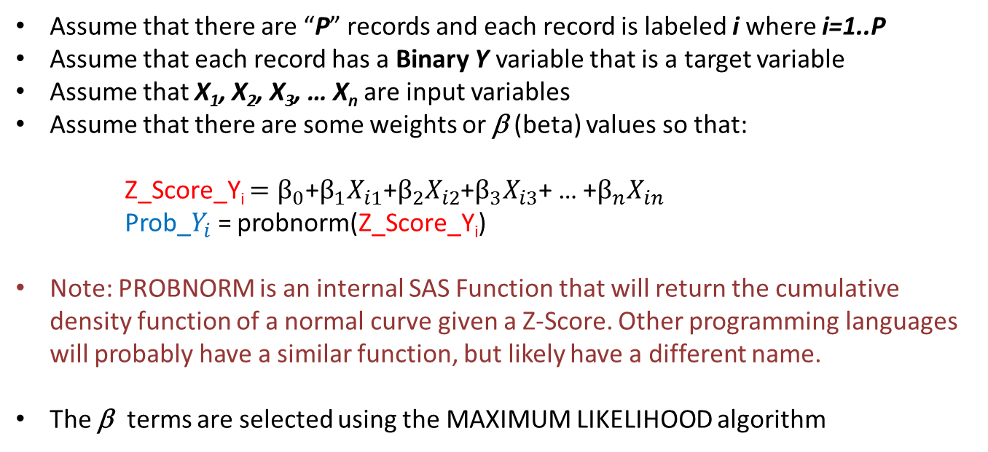
Probit Regression Review
Assume that there are “P” records and each record is labeled i where i=1..P
Assume that each record has a Binary Y variable that is a target variable
Assume that X₁, X₂, X₃, … X_{n} are input variables
Assume that there are some weights or β (beta) values so that:
Z_Score_Y_{i} $=β_{0}$+$β_{1}X_{i1}\text{+}β_{2}X_{i2}$+$β_{3}X_{i3}$+ … +$β_{n}X_{in}$
Prob_$Y_{i}$= probnorm(Z_Score_Y_{i})
Note: PROBNORM is an internal SAS Function that will return the cumulative density function of a normal curve given a Z-Score. Other programming languages will probably have a similar function, but likely have a different name.
The β terms are selected using the MAXIMUM LIKELIHOOD algorithm

Slide 29
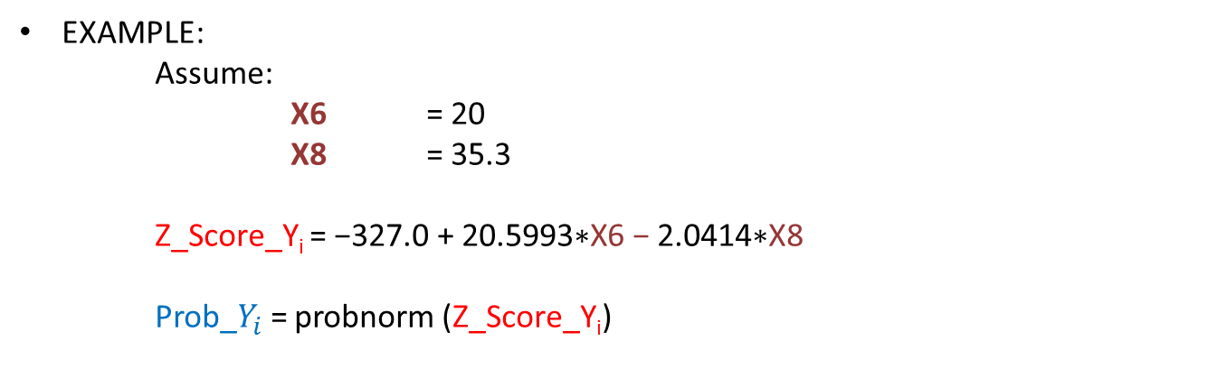
Probit Regression Review
EXAMPLE:
Assume:
X6 = 20
X8 = 35.3
Z_Score_Y_{i} = $\text{−327.0 + 20.5993∗}\text{X}\text{6 − 2.0414∗}\text{X}\text{8}$
Prob_$Y_{i}$= probnorm (Z_Score_Y_{i})

Slide 30
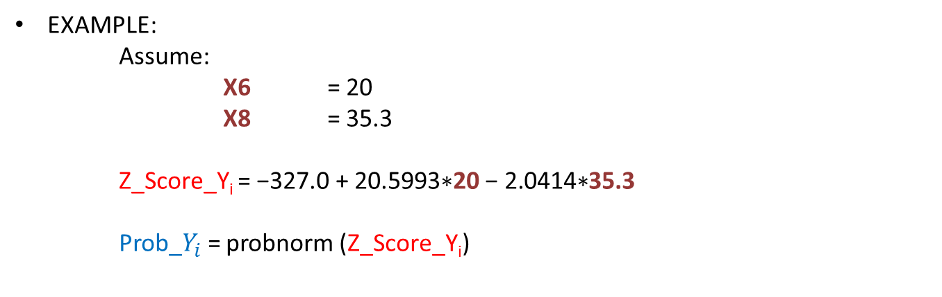
Probit Regression Review
EXAMPLE:
Assume:
X6 = 20
X8 = 35.3
Z_Score_Y_{i} = $\text{−327.0 + 20.5993∗}\text{20}\text{ − 2.0414∗}$35.3
Prob_$Y_{i}$= probnorm (Z_Score_Y_{i})

Slide 31
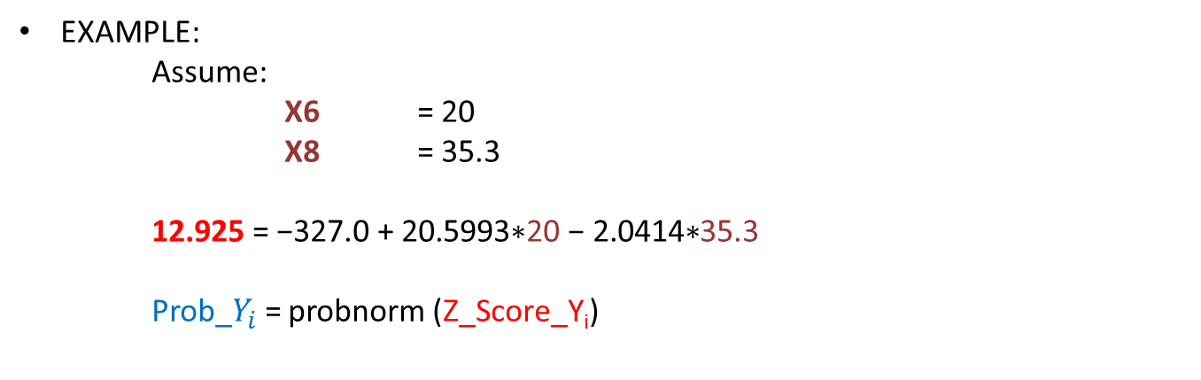
Probit Regression Review
EXAMPLE:
Assume:
X6 = 20
X8 = 35.3
12.925 = $\text{−327.0 + 20.5993∗}\text{20}\text{ − 2.0414∗}$35.3
Prob_$Y_{i}$= probnorm (Z_Score_Y_{i})

Slide 32
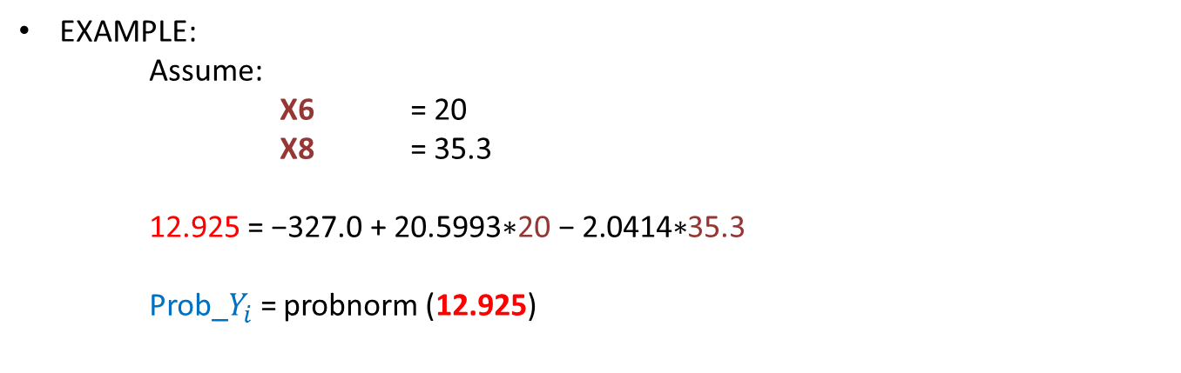
Probit Regression Review
EXAMPLE:
Assume:
X6 = 20
X8 = 35.3
12.925 = $\text{−327.0 + 20.5993∗}\text{20}\text{ − 2.0414∗}$35.3
Prob_$Y_{i}$= probnorm (12.925)

Slide 33
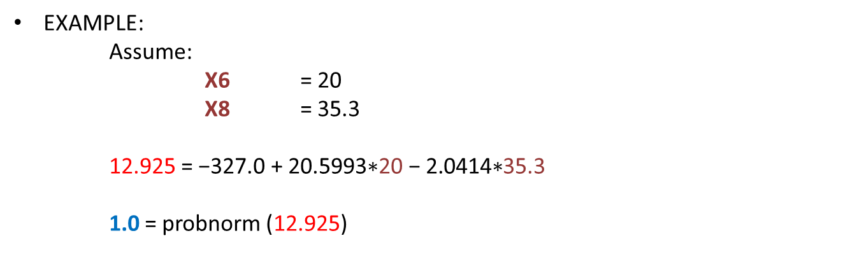
Probit Regression Review
EXAMPLE:
Assume:
X6 = 20
X8 = 35.3
12.925 = $\text{−327.0 + 20.5993∗}\text{20}\text{ − 2.0414∗}$35.3
1.0 = probnorm (12.925)

Slide 34

Probit Regression Review
EXAMPLE:
Assume:
X6 = 20
X8 = 35.3
12.925 = $\text{−327.0 + 20.5993∗}\text{20}\text{ − 2.0414∗}$35.3
1.0 = probnorm (12.925)
PROB that Y=1 is 100%

Slide 35
Probit Regression : Example
Probit Regression is really easy in R. It is essentially the same as Logistic Regression
myprobit <- glm(y ~ x6 + x8, family = binomial(link = "probit"), data = mydata)
myprobit
However …. As with LOGISTIC Regression:
The data set is small and it is perfectly separable. Therefore, there are an infinite number of solutions that will separate the “1” and “0” values.
Therefore, even though there are different solutions, all of these are correct.

Slide 36
Probit Regression : Example
When the parameter estimates are hard coded to export the model, we have:
############### Exporting Probit Model
temp <- -359.612 + 22.757*x6 - 2.279*x8
p_probit2 <- pnorm(temp,mean=0,sd=1)
mydata <-cbind.data.frame(mydata,p_probit2)
Note the use of the pnorm function. This generates the normal cumulative probability up to the value of TEMP, in this function.
In other words, P(Y<=TEMP) under the standard normal distribution.

Slide 37
Probit Regression : Example

